Slide 1

PegHead
Project Maroon

Slide 2
Enoch: Brief Introduction
In PegHead, you are a vengeance seeking pirate after your insurance claim for a new head was denied by your insurance company.
Goal: A punishing side-scroller where persistence and pirateering come first.

Slide 3
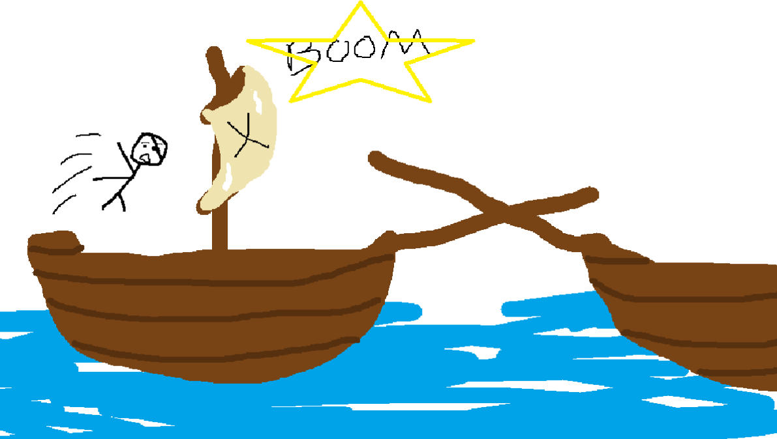
Josh: Storyboard
PegHead: The video game opens with a black screen and text introducing the background of the game
Dialogue: "While on a quest for treasure, suddenly a ship rams into yours, and you find yourself in the air. You land on your head and blackout..."

Slide 4

Josh: Storyboard
PegHead (post-op) (concept art)
PegHead: PegHead's head was so disfigured that he needed a head transplant (science has come a long way).
Thankfully, he had health insurance. However, his insurance claim got denied, so the only thing he could afford was a peg leg attached to his head.
Dialogue: "You wake up in an infirmary, but your head feels weird, let's hope you're okay, knock on wood."

Slide 5
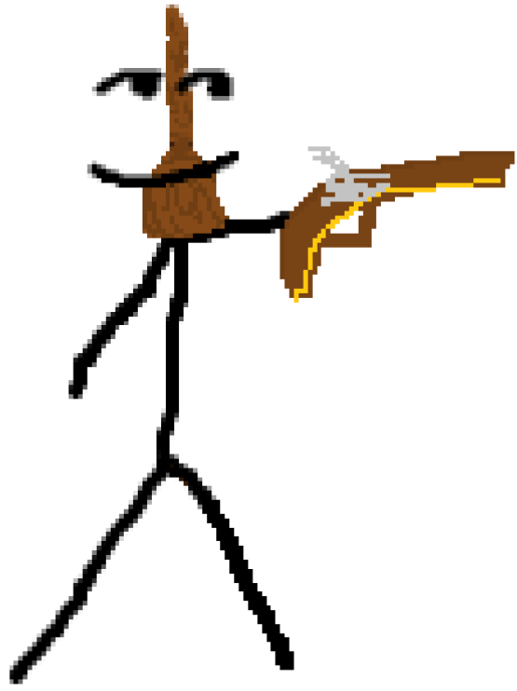
Josh: Storyboard
PegHead, armed to the teeth
PegHead: PegHead is VERY mad his insurance claim got denied. It's time to take matters into his own hands. Peghead leaves the infirmary, armed with a gun, trying to exact his revenge.
Action: Complete tutorial by moving, crouching, jumping, and shooting.
Dialogue: "You've been in the hospital for quite some time, you need to find your bearings before you begin your adventure."

Slide 6
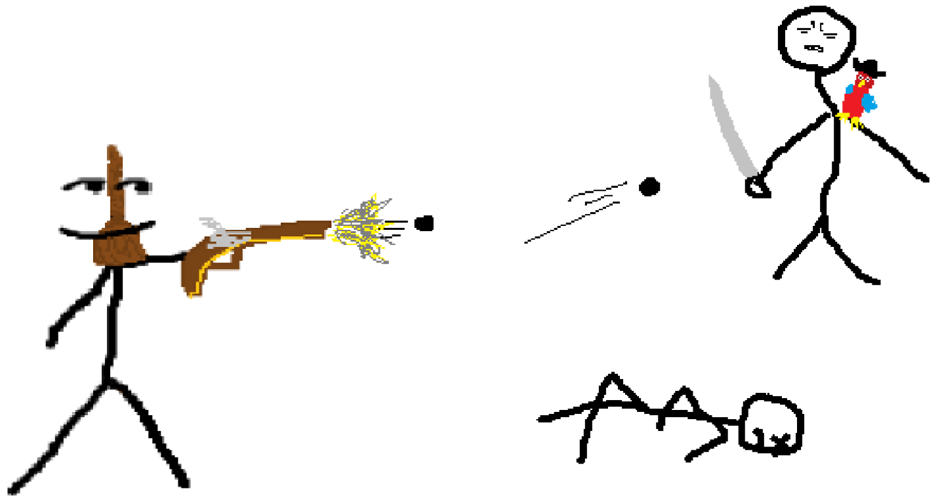
Josh: Storyboard
PegHead: PegHead plays level one, where he must defeat all goons to get one step closer to the person who wronged him.
Action: Complete level one by moving, shooting enemies, avoiding attacks, and ultimately reaching the end of the level.
Dialogue: "You enter the fray, with a vengeance, ready to slay any who stand in your way."

Slide 7
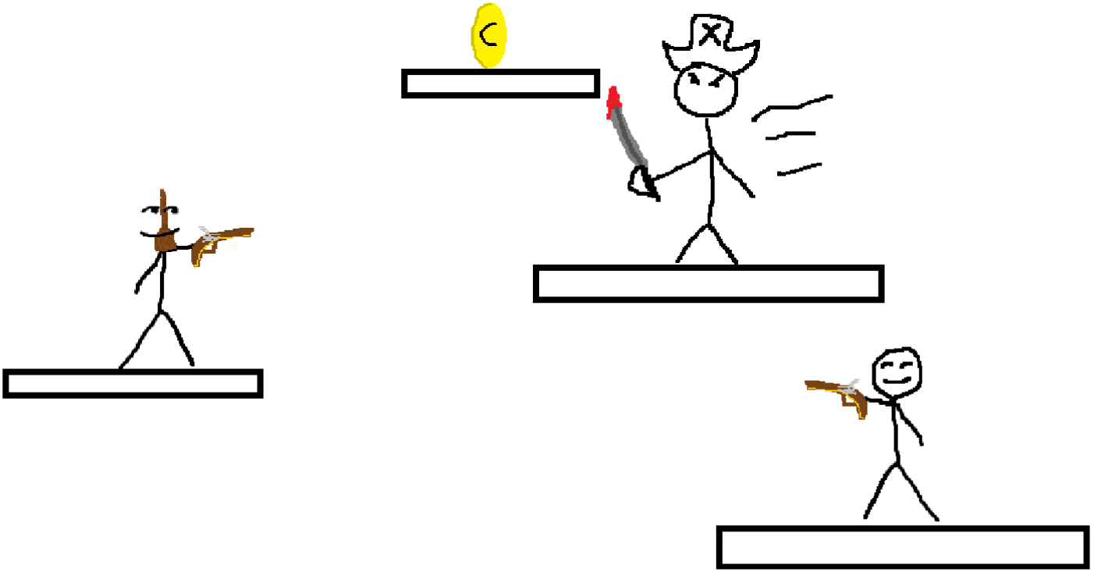
Josh: Storyboard
PegHead: PegHead enters level two. He feels he's getting closer to finding the person behind this.
Action: Maneuver around map, shoot enemies, dodge projectiles, use power-ups, reach the end of level.
Dialogue: "You see more waves of enemies, but the end is in sight."

Slide 8
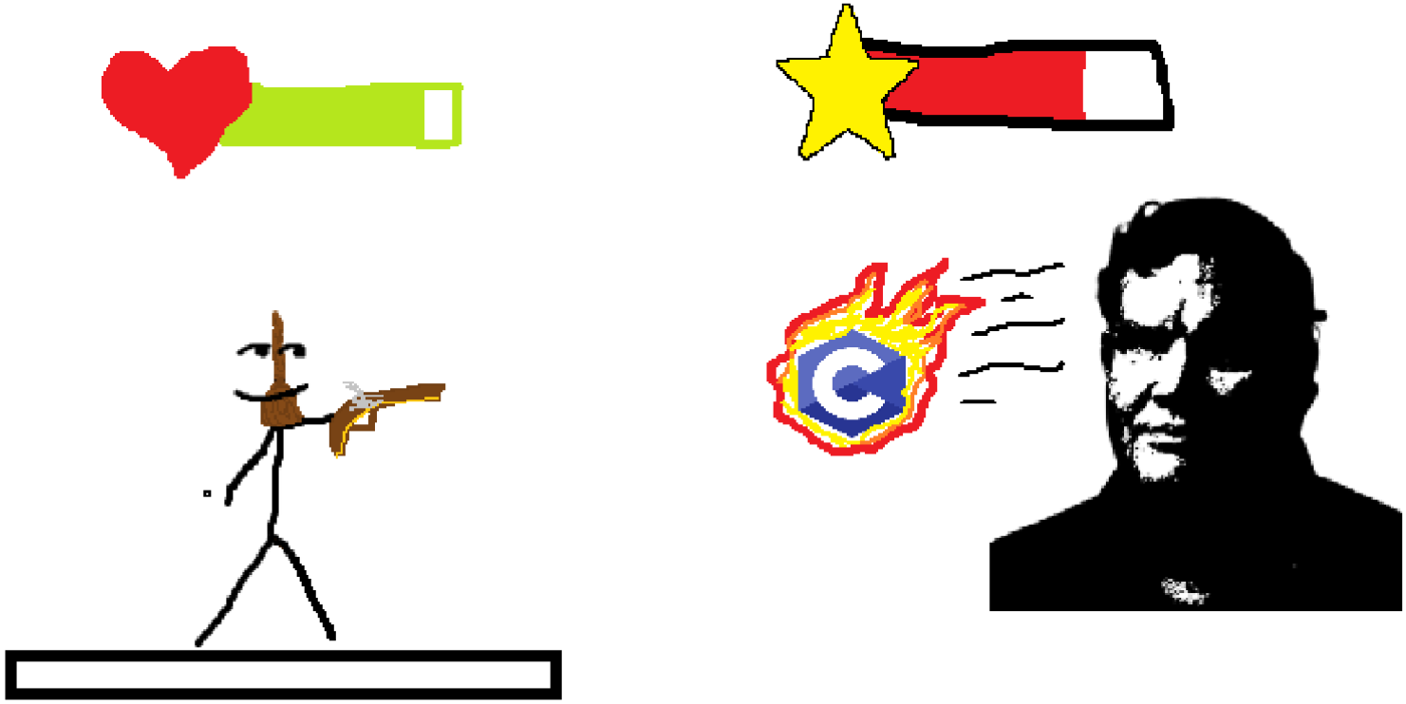
Josh: Storyboard
PegHead: PegHead encounters the final boss. The boss shoots out projectiles that deplete PegHead's vitamin C stores, causing death by scurvy.
Action: Dodge projectiles, maneuver around the arena, defeat the boss.
Dialogue: "You feel the ground shake as a towering figure emerges from the shadows. It's time to prove yourself once more."

Slide 9

Josh: Storyboard
(final scene concept art, we do not condone violence)
PegHead: After defeating the final boss, PegHead finds and defeats the health insurance CEO, bringing an end to his treacherous journey.
Dialogue: "You lay your eyes on the CEO. With your flintlock in hand, you set out to finish what you've started."

Slide 10
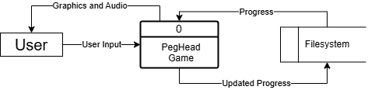
Enoch: Context Diagram

Slide 11
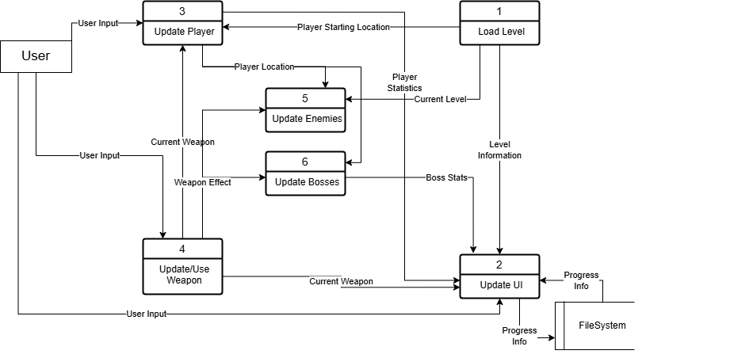
Enoch: Diagram 0

Slide 12
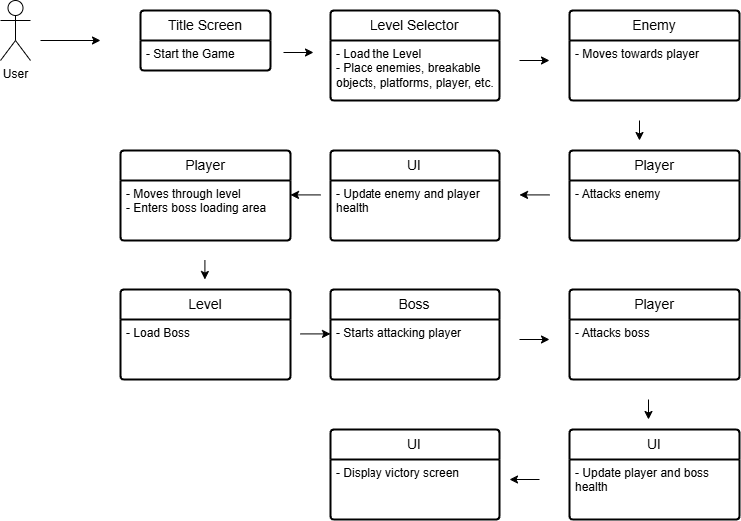
Global Use Case

Slide 13
Enoch: Player Movement
Player movement in the game is controlled through directional inputs on the keyboard (WASD or Arrowkeys), allowing the player to move left, right, jump, and dash, with the physics system handling collision detection and movement constraints to ensure smooth and responsive gameplay.
High Priority: The user wouldn’t have a game to play without a player.
Low Complexity: Just need to design an intuitive and rewarding movement system.

Slide 14
Enoch: Player Attack System
The attack system is responsible for handling player combat mechanics, including attack animations, hit detection, and any damage interactions. It will ensure a smooth and rewarding combat movement system.
High Priority: The user wouldn’t enjoy the game if all they could do was move around.
Medium Complexity: Need to make sure the combat is fair, rewarding, but still difficult.

Slide 15
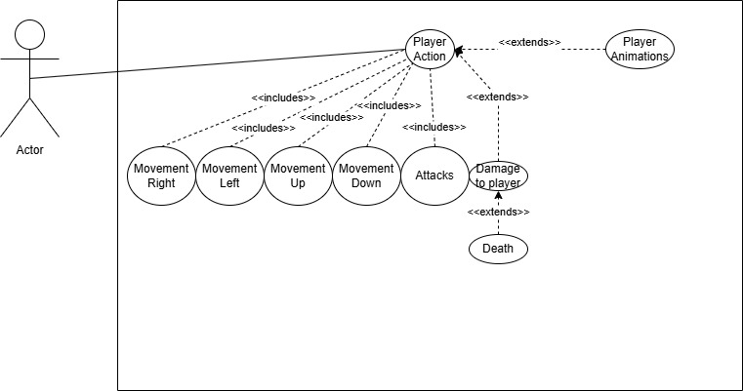
Enoch: Use Case Diagram

Slide 16
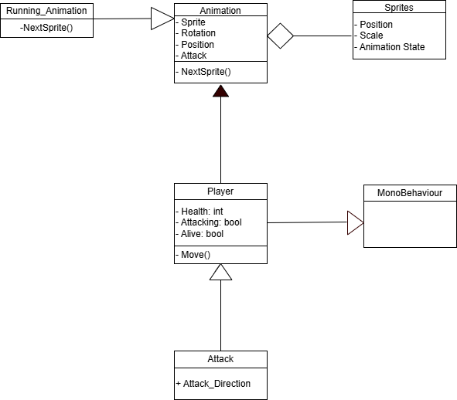
Enoch: Class Diagram

Slide 17
Levels: Introduction - Miles
The Level Layout System is a core feature of our game that determines how players navigate through each stage. It includes terrain design, enemy placements, platform arrangements, and interactive elements such as traps, moving platforms, and collectibles.
This system ensures that each level provides a balanced mix of challenge, flow, and exploration

Slide 18
Levels: Priority - Miles
The Level Layout System is a top-priority feature in our platformer game. Since platformers are inherently built around movement, jumping, and interaction with the environment, level design directly impacts gameplay quality, difficulty balance, and player retention.
Why It’s a High Priority:
Core Gameplay Foundation – The level layout dictates how players experience movement, combat, and exploration. Poor level design can break the game.
Difficulty Balancing – Ensures smooth progression from beginner-friendly areas to challenging sections without frustration.
Player Engagement & Replayability – Well-designed levels encourage players to revisit for speedruns, secrets, or alternative paths.
Integration with Other Features – Directly affects enemy placements, power-up distribution, and narrative elements, making it a central system.

Slide 19
Levels: Global use cases - Miles
Guiding the player
Early levels such as the tutorial teach mechanics. While later levels are designed to test the players skills
Pacing
Well-designed layouts create fast paced sections and slower safe zones
Vertical vs. horizontal layouts affect movement speed and flow of the level
Obstacles
Jumping puzzles, enemy placements, and environmental hazards create obstacles that force the player to adapt their strategy in real time
Some layouts should focus on precision, while others emphasize reaction time or strategy.
Interactive Environments
Moving platforms, destructible terrain, or gravity shifts
Environmental storytelling (e.g., ruins, factories, forests) adds depth to the world.

Slide 20
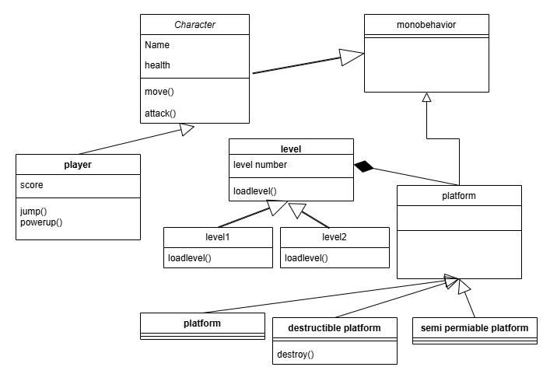
Levels: Class Diagram - Miles

Slide 21
Levels: Complexity - Miles
The Level Layout Design System is a moderate-to-high complexity feature compared to other aspects of the game.
Its complexity arises from the need to balance level design, player progression, environmental storytelling, and interaction with other gameplay mechanics.
Key Factors Affecting Complexity:
Manual vs. Procedural Design – Hand-crafted levels require design iteration, while procedural generation demands complex algorithms.
Interactive Elements – Moving platforms, breakable terrain, dynamic physics objects, and environmental hazards increase complexity.
Testing & Iteration – Requires extensive playtesting to ensure flow, fairness, and fun.

Slide 22
Levels: Overall - Miles
The Level Layout Design System is one of the most critical and complex features.
Second only to core movement mechanics and AI behavior.
While not as technically demanding as AI, it requires extensive work and refinement to create a polished experience.

Slide 23

Isaac – Sound
Background music
Sound effects
Parallax
Medium complexity – Just playing sounds but need parallax.
High priority - Gameplay is significantly more engaging for the player.

Slide 24
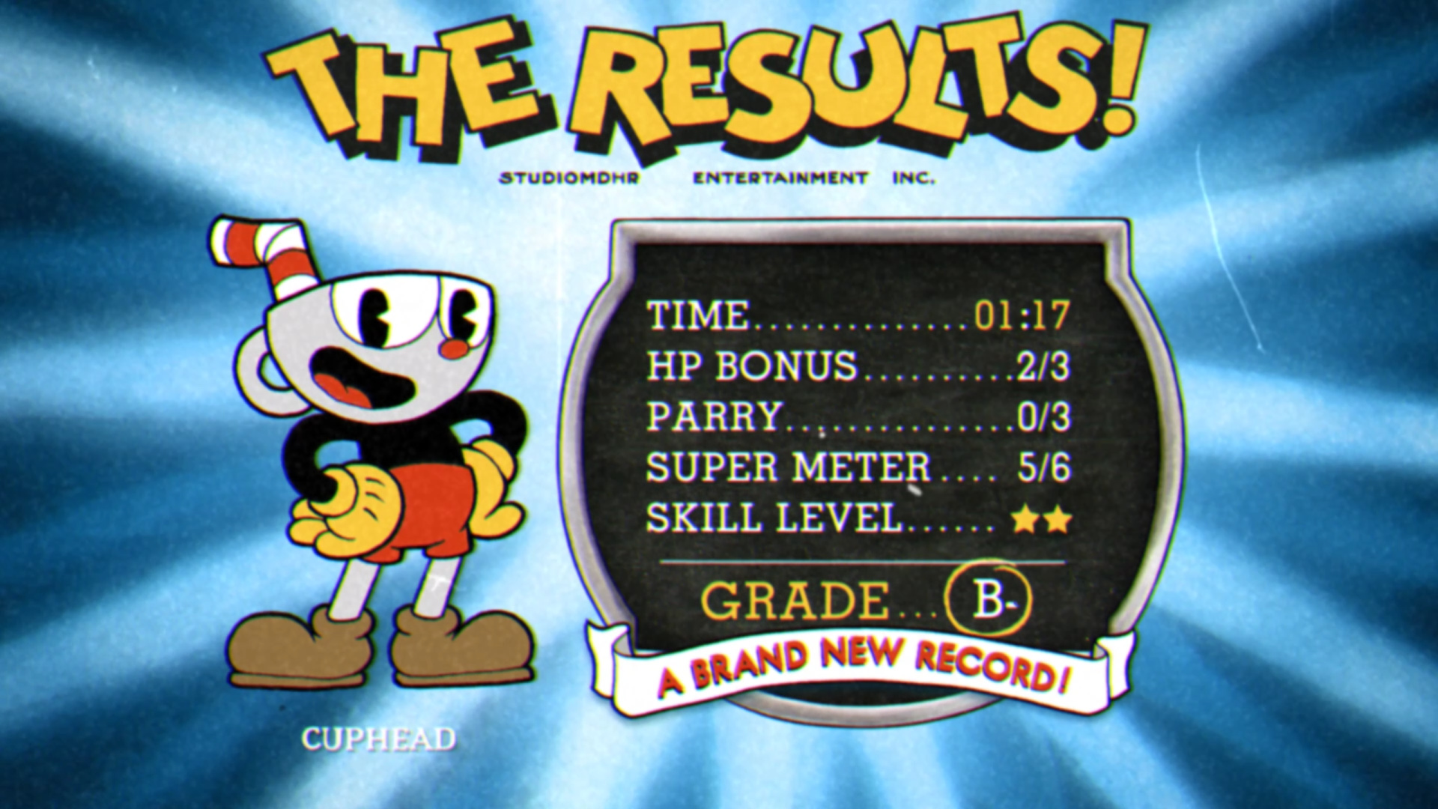
Isaac – UI
Play screen
Level select UI
Results screen
HUD
Medium complexity – Buttons + text but need to be laid out cohesively.
High priority - Gameplay is impossible if the user can't press play.

Slide 26
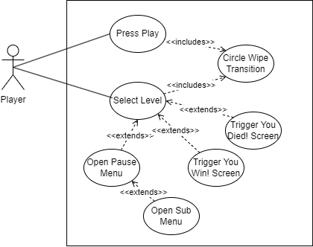
Isaac – UI Use Case

Slide 27
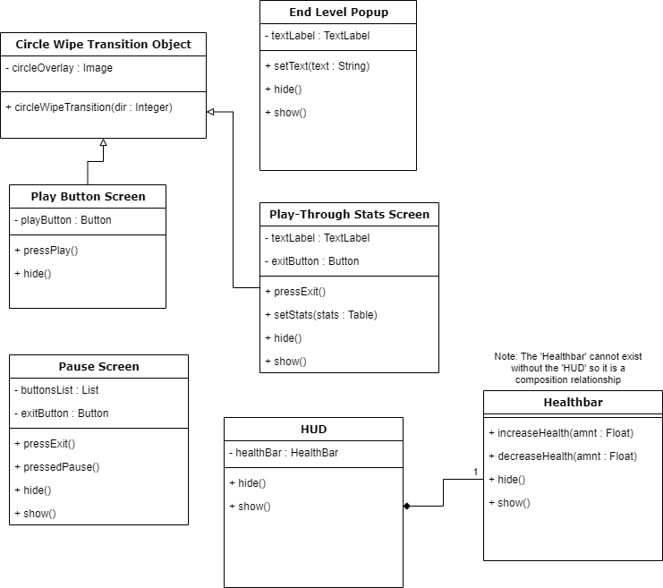
Isaac – UI Class Diagram

Slide 28
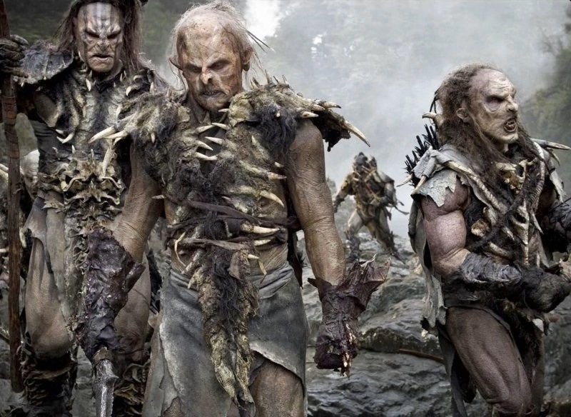
Josh: Enemies!
CEO's goons
Health
Attacks
Enemy deaths
Spawns
Detection
High Priority
Medium Complexity
Enemy "AI"

Slide 29
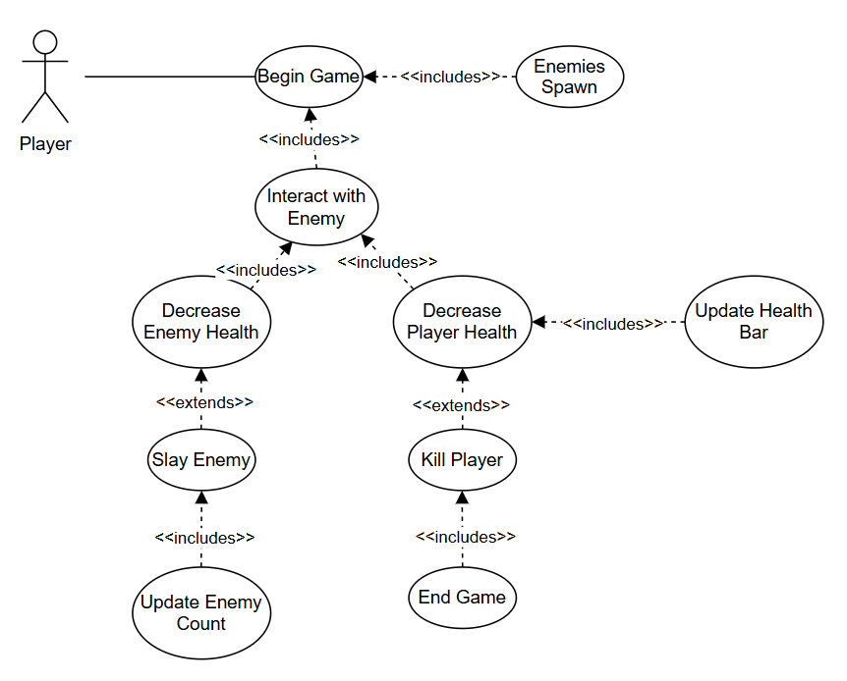

Josh: Enemies! - Use Case Diagram
picture unrelated

Slide 30
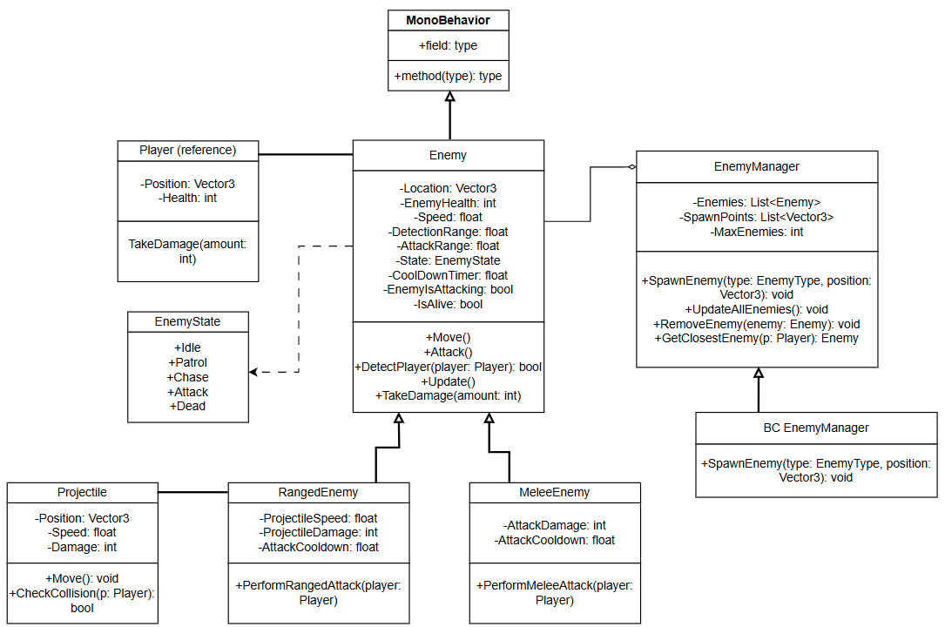
Josh: Enemies! - Class Diagram

Slide 31

Feature: Boss Jonathan Palmer
The boss fight in our game is designed to be a test of everything the player has learned so far with movement, timing, and strategy. When players face the boss, they’re confronted with a harder challenge that forces them to think more than any of the general enemies. The boss has several tactics, with the fight intensifying when its health drops to a certain point. A central Fight Manager will monitor collisions and update health bars so the player will know how hurt the boss is.

Slide 32
Boss Priority Jonathan Palmer
As far as development priority goes, I’d rate the boss fight at about a 3 out of 10. It’s hopefully one of the most thrilling parts of the game, but it’s not absolutely required to get our core story across. If we run out of time or resources, we could still deliver the narrative without the boss fight.

Slide 33
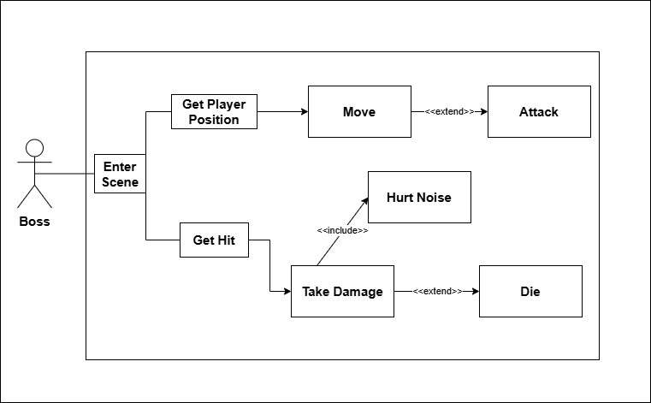
Boss Use Case Jonathan Palmer
First when the player initiates the boss fight the Boss will enter the scene, this is when the logic and behavior will be initialized.
Once the fight has started the boss will constantly monitor the player position to act accordingly, depending on the player position the boss may also extend to attack with its movement, being melee if close or ranged if further.
When the boss gets hit by the player it will take damage which will include a noise indicating they’ve taken damage, in the case of the boss's health dropping below 1 the action will extend to the boss dying.

Slide 34
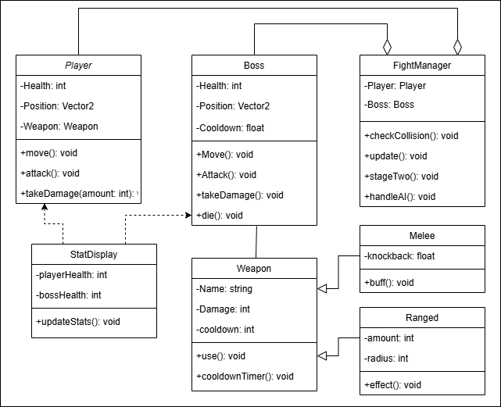
Boss Class Diagram Jonathan Palmer
The Player class has straightforward attributes like health and position, and will interact with the boss through moving and attacking.
The Boss class holds the logic, comparing positions and determining which action to move forward with. It will react to interactions with the player and once health drops to zero it will trigger the winning scene.
The StatDisplay class is dependent on the Player and Boss classes, tracking and displaying the current state of the boss fight for the player.
The FightManager class is basically the referee, tracking collisions, updating stats, and handing changes in the fight. Player and Boss classes compose, but do not belong to this class.
The Weapon class will be part of both the player and the boss, with subclasses of weapons being able to choose from Melee class or Ranged class attacks on the player.

Slide 35
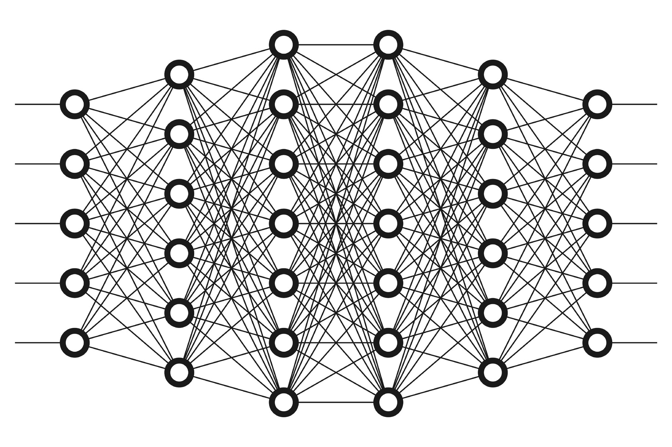
Boss Complexity Jonathan Palmer
When it comes to complexity, I’d put this boss fight around a 6 out of 10. The main reason it doesn’t go higher is because it relies on more straightforward math and a decision tree, just enough to handle basic pathfinding, target tracking, and attack decisions. The boss knows when to move in, when to hang back, and how to keep the player thinking. If you wanted to push this system to its limit it could be a 10 out of 10 complexity by using AI like neural networks that adjust to the player’s strategies, adapting its own behavior to create a formidable, evolving threat.

Slide 36
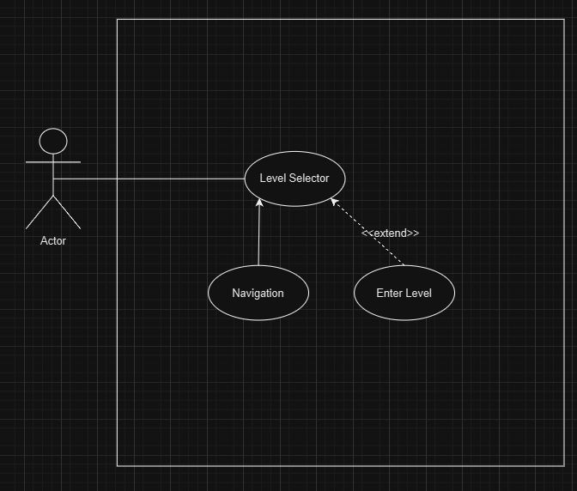
Keagan: Level Selector and Assets
Use Case

Slide 37
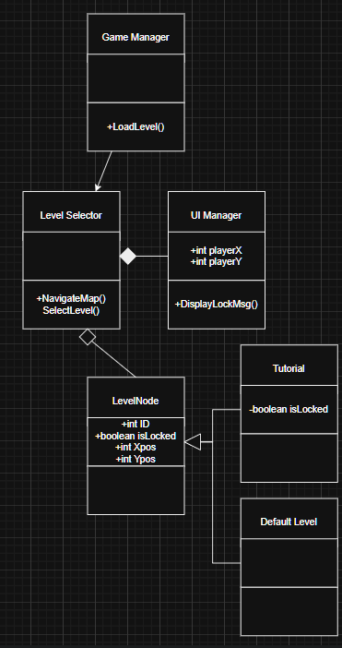
Keagan: Class Diagram
Complexity: Low
Priority: High

